Slide 1
What the DAAM: Interpreting Stable Diffusion Using Cross Attention
Authors: Raphael Tang, Linqing Liu, Akshat Pandey, Zhiying Jiang, Gefei Yang, Karun Kumar, Pontus Stenetorp, Jimmy Lin, Ferhan Ture
Presented by: Alex Lin, Jason Jabbour, Mark Mazumder

Slide 2
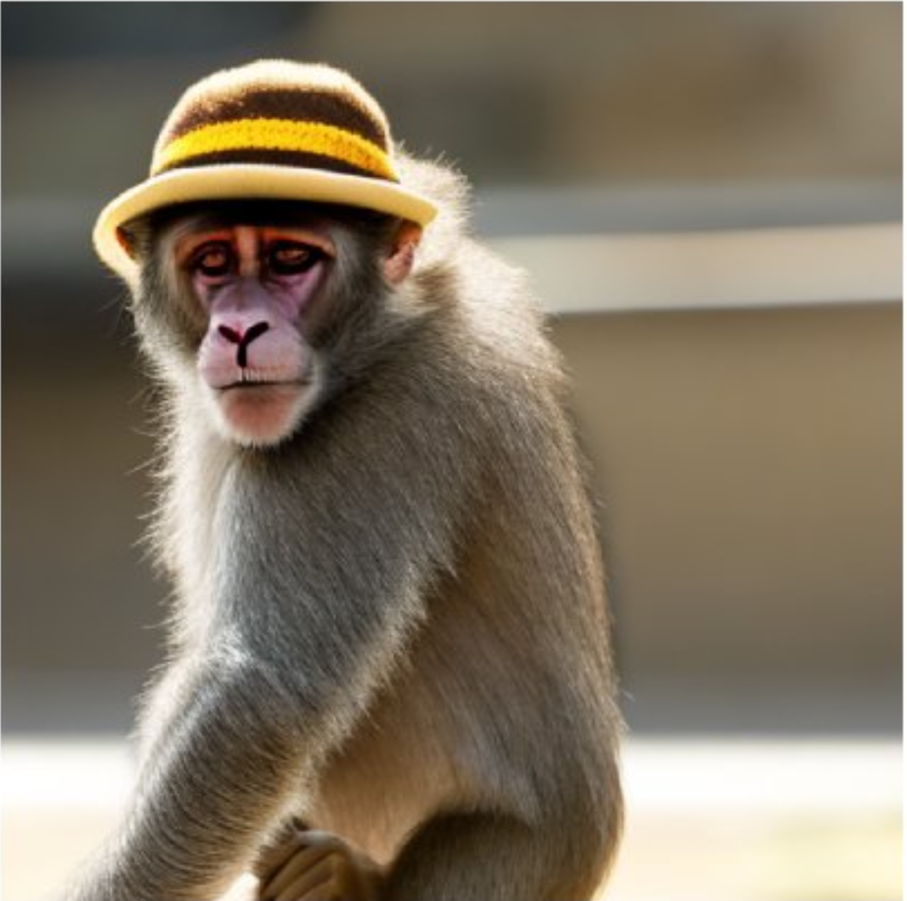
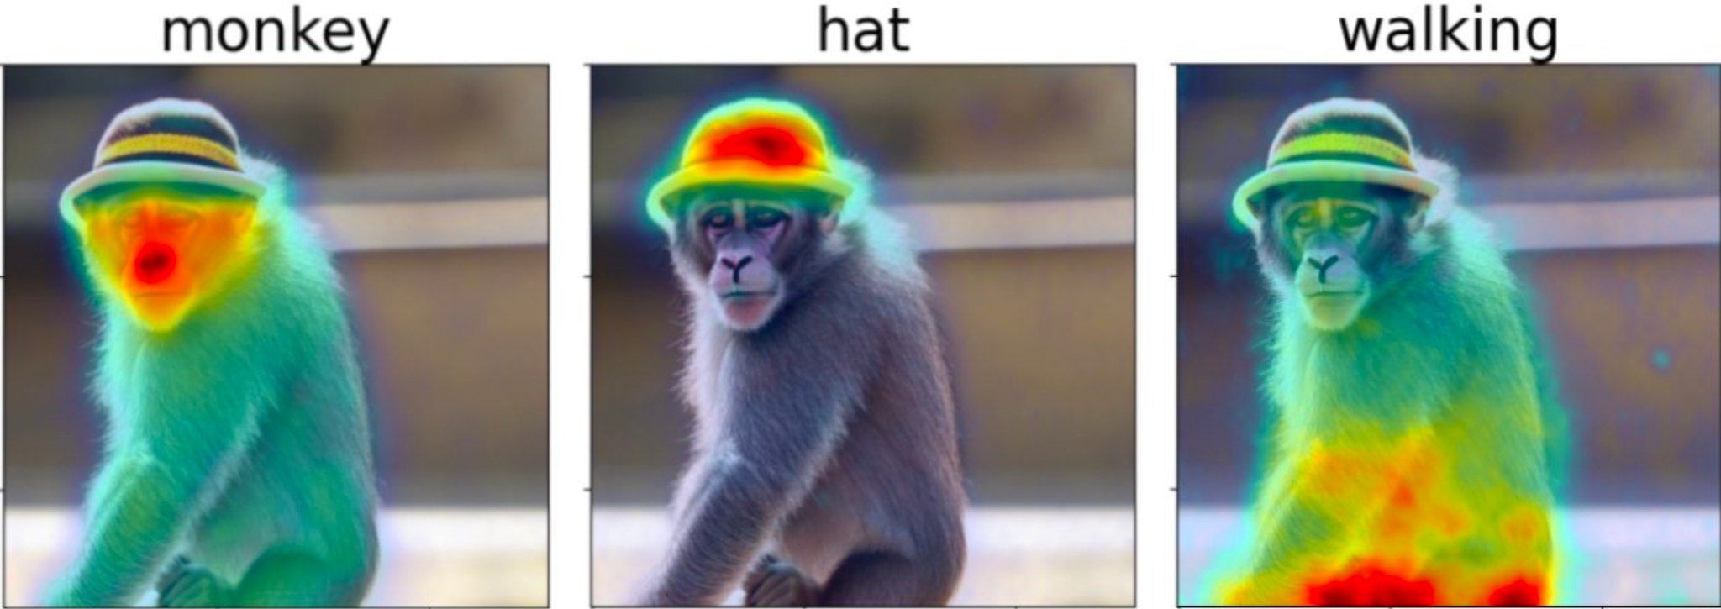
Outline
Stable Diffusion: Text to Image Model
INPUT TEXT PROMPT
“monkey with hat walking”
Related work
Background: (simplified) Stable Diffusion
DAAM for text-to-image attribution
Results
Attribution quality analysis
Syntax to pixels
Entanglement
Limitations & discussion
OUTPUT IMAGE
DAAM: Diffusion Attentive Attribution Maps
DAAM estimates per-pixel attribution for each word in a prompt (post-hoc)

Slide 3
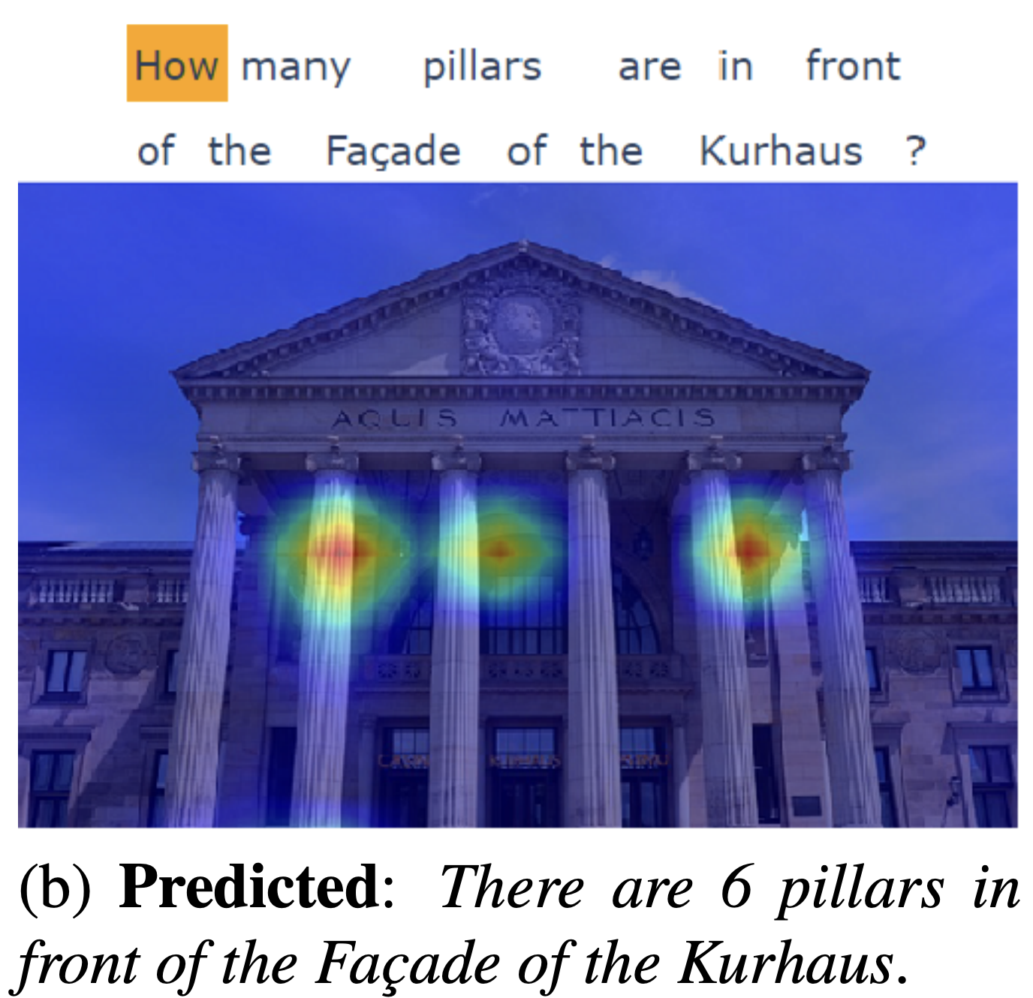
Related Work
Cross-Attention
Vision-Language (VQA…)
Generative Models (GANs..)
Attention is Not Explanation [Jain et al.]
Attention is Not Not Explanation [Wiegreffe et al.]
[2203.17247] VL-InterpreT: An Interactive Visualization Tool for Interpreting Vision-Language Transformers [Aflalo et al]
This work applies existing techniques (cross-attention) to an open source, SOTA diffusion model to probe limitations
Textual perturbation (Wallace et al., 2019), Attentional Visualization (Vig, 2019; Kovaleva et al., 2019, Shimoaka et al., 2016) and information bottlenecks (Jiang et al., 2020) to relate important input tokens to outputs of large language models
Probing vision transformers for verb understanding (Hendricks and Nematzadeh, 2021)
Enhancing diffusion models using prompt engineering (Hertz et al, 2020; Woolf, 2020)
Disentangling e.g., style and spelling (Karras et al., 2019; Materzynska et al., 2022)

Slide 4

Diffusion Models vs: GANs, VAEs, Flow
Source: https://lilianweng.github.io/posts/2021-07-11-diffusion-models/

Slide 5
Diffusion Models vs: GANs, VAEs, Flow
“single-pass” encoder-decoder models
Source: https://lilianweng.github.io/posts/2021-07-11-diffusion-models/

Slide 6
Diffusion Models vs: GANs, VAEs, Flow
“single-pass” encoder-decoder models
Multi-step time-series
Source: https://lilianweng.github.io/posts/2021-07-11-diffusion-models/

Slide 7
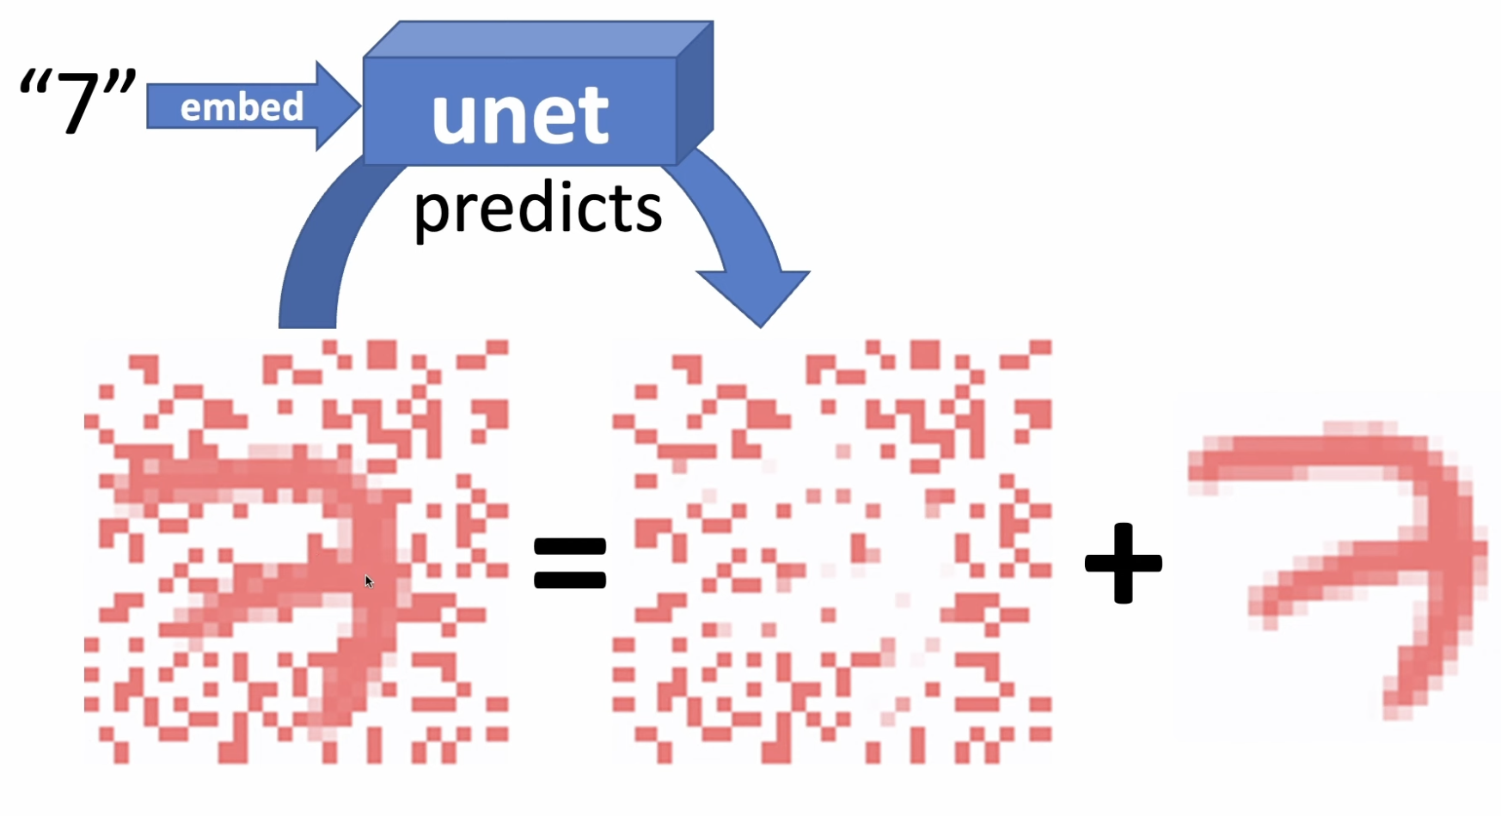
Image Generation: Predict and subtract noise
Conditioning:
Source: Lesson 10: Deep Learning Foundations to Stable Diffusion, 2022

Slide 8
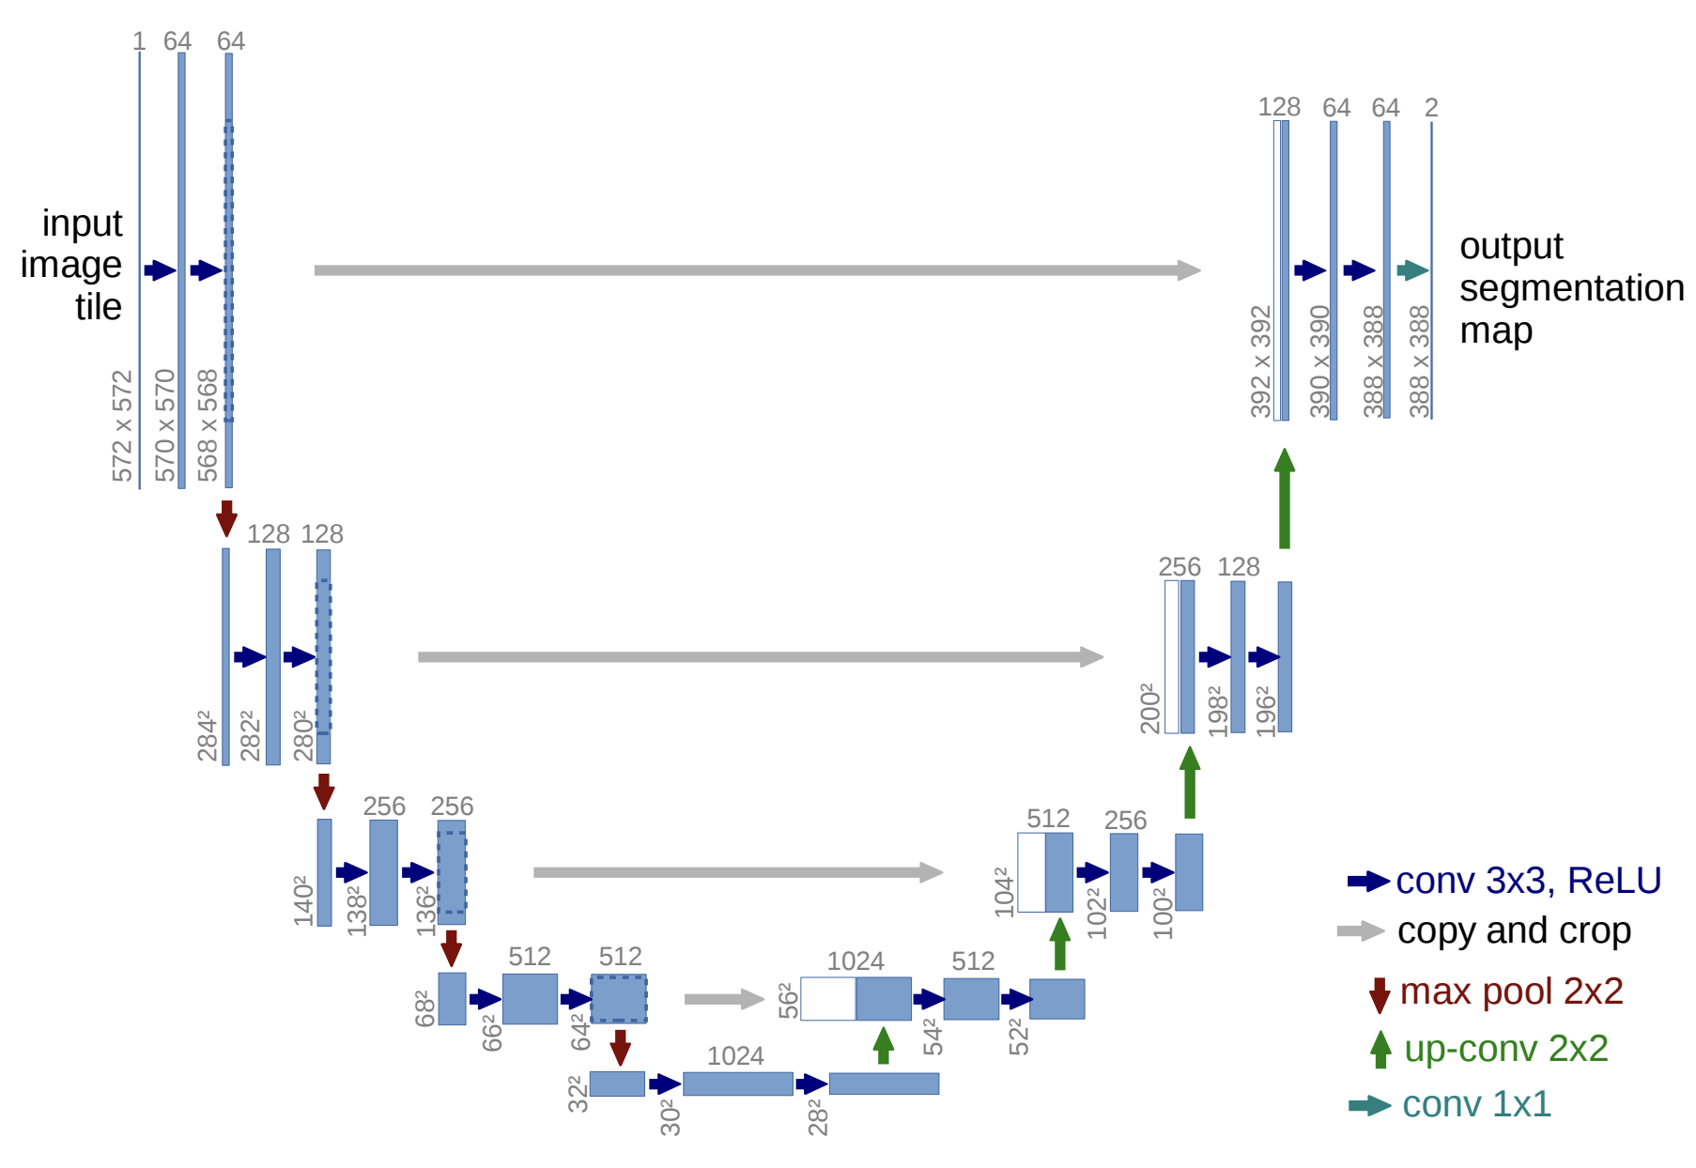
UNet Architecture
[1505.04597] U-Net: Convolutional Networks for Biomedical Image Segmentation

Slide 9
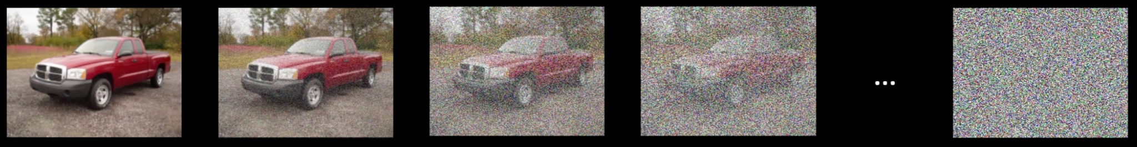
Forward Process: Noise Schedule
Fixed additive noise model: 𝞊
Add noise for time steps t in {0, …, 30}
Image Source: Diffusion models from scratch in PyTorch

Slide 10
Reverse Process: Learned Noise Estimate
Fixed additive noise model: 𝞊
Add noise for time steps t in {0, …, 30}
Image Source: Diffusion models from scratch in PyTorch
Denoising model: 𝞊_{𝛳}(image, timestep)

Slide 11
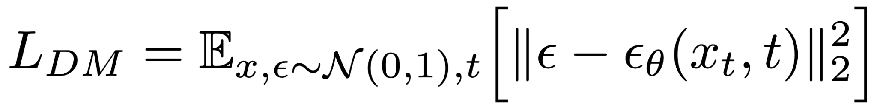
Diffusion Model Loss
Error of noise reconstruction
Source: High-Resolution Image Synthesis with Latent Diffusion Models

Slide 12
Diffusion Model Loss
Squared Euclidean Norm
Added noise (from Normal distribution)
Denoising
Model
Error of noise reconstruction
Image at time t
Source: High-Resolution Image Synthesis with Latent Diffusion Models

Slide 13
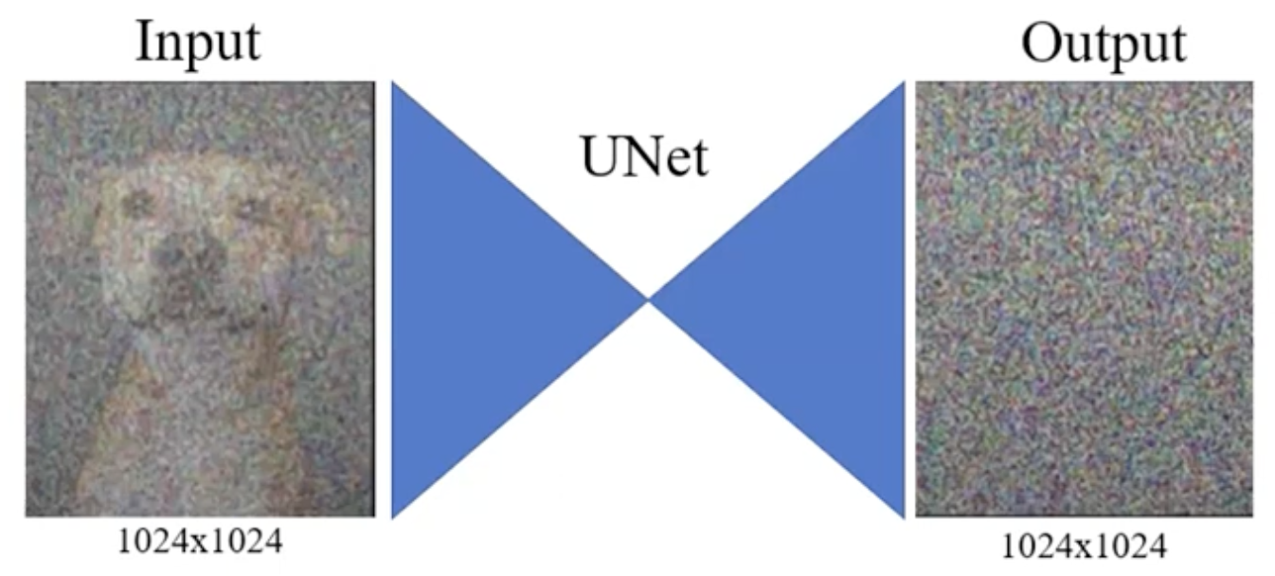
Diffusion Model Loss
Squared Euclidean Norm
Added noise (from Normal distribution)
Denoising
Model
Time-
Conditional UNet
Image at time t
Reasoning about noise in pixel space is challenging
Source: High-Resolution Image Synthesis with Latent Diffusion Models

Slide 14
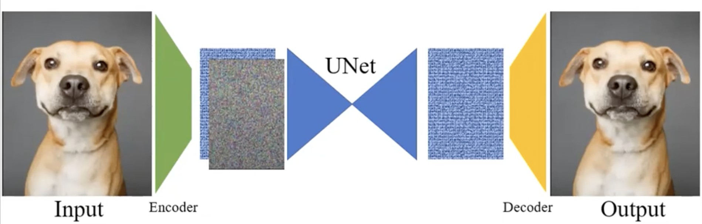
Diffusion Model Loss
Squared Euclidean Norm
Added noise (from Normal distribution)
Denoising
Model
Denoised image in latent space
Image at time t
Easier to estimate noise in latent space!
Add noise in latent space
Source: High-Resolution Image Synthesis with Latent Diffusion Models

Slide 15
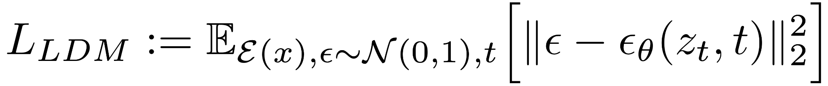
Latent Diffusion Model Loss
Squared Euclidean Norm
Added noise (from Normal distribution)
Denoising
Model
Image at time t
Latent space encoder
Latent representation of image at time t
Source: High-Resolution Image Synthesis with Latent Diffusion Models

Slide 16
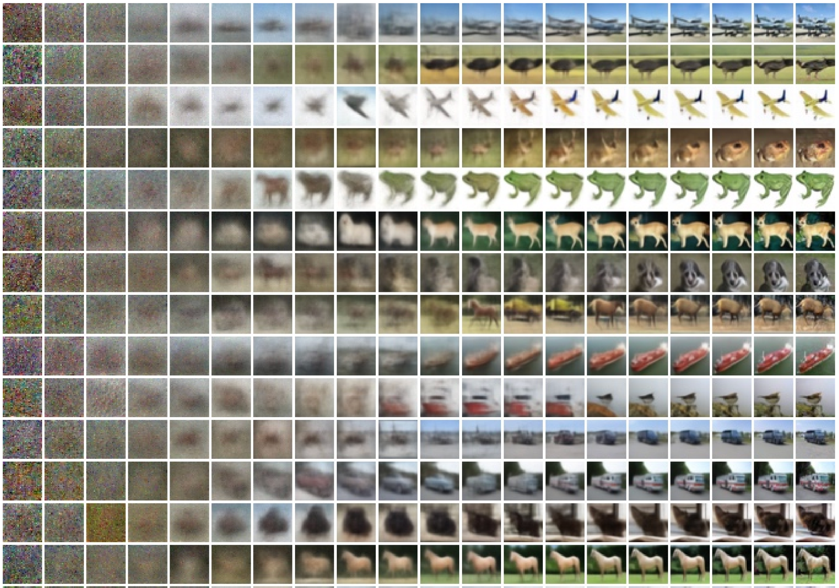
Unconditional Sampling from Noise
https://arxiv.org/abs/2006.11239
Conditional Generation?
How do we go from a text prompt to an image?
Random Noise

Slide 17
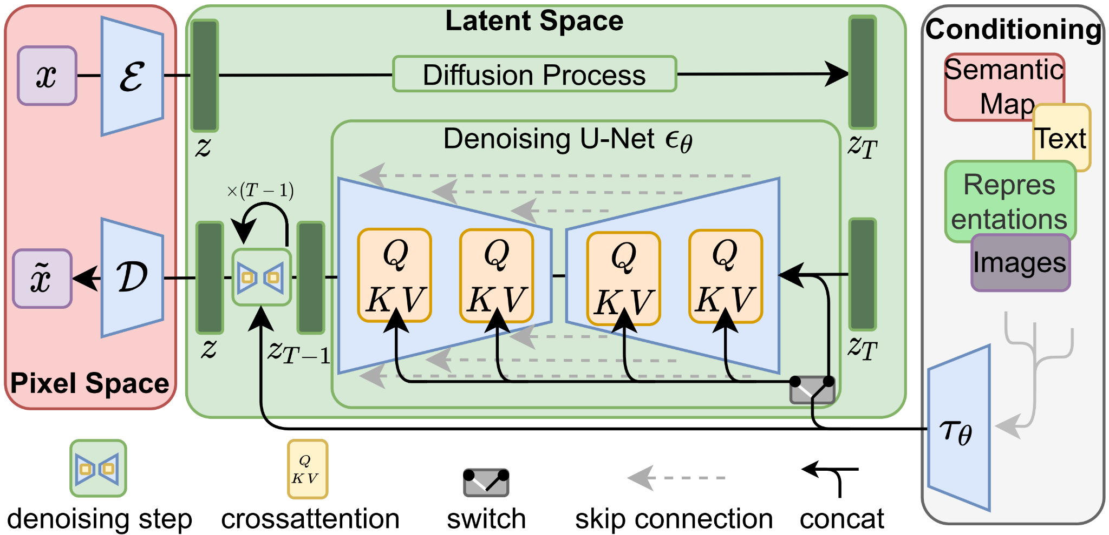
Stable Diffusion Architecture
[2112.10752] High-Resolution Image Synthesis with Latent Diffusion Models

Slide 18
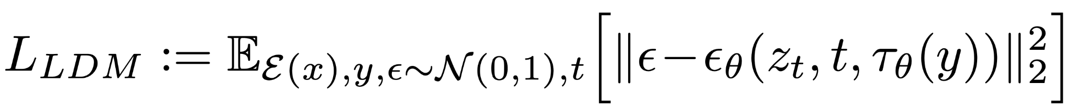
Stable Diffusion Architecture
Additionally parameterized on text encoding
[2112.10752] High-Resolution Image Synthesis with Latent Diffusion Models
Trained on 5B image-caption pairs
BERT Tokenizer
Intermediate Transformer

Slide 19
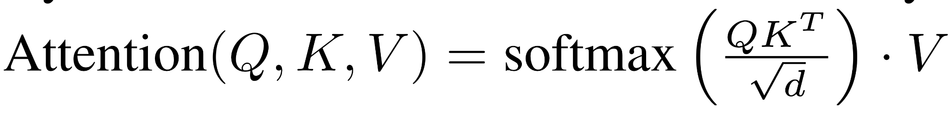
Cross-Attention for Text Conditioning
UNet block i
Text encoder
Text encoder
Queries: image tokens
Keys, Values: prompt tokens
DAAM estimates per-word attribution via this cross-attention for each subset of prompt tokens

Slide 20
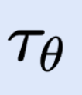
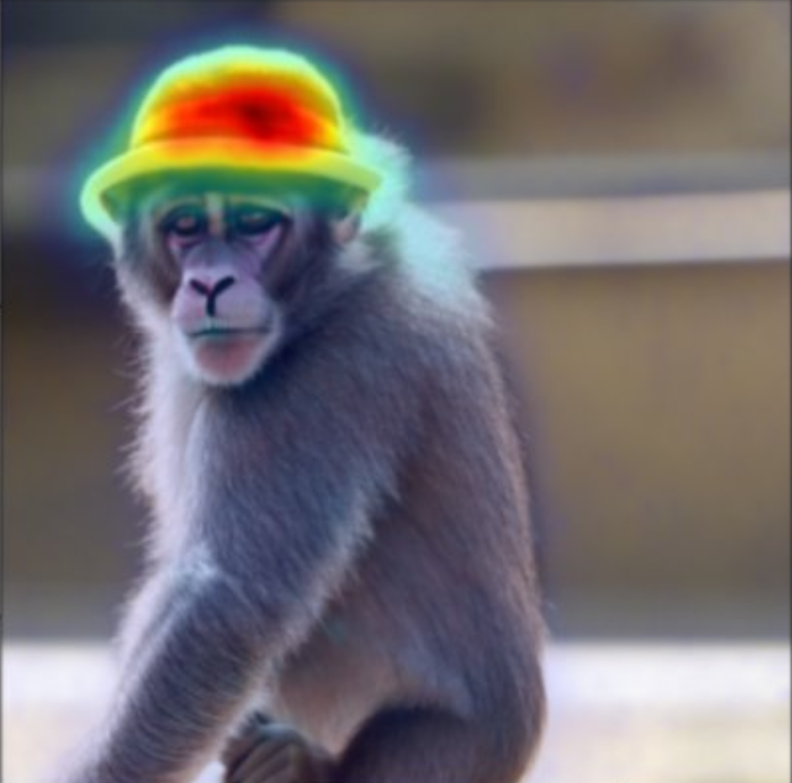
DAAM Per-Word Heatmaps
TOKEN
INPUT TEXT PROMPT
“monkey with hat walking”
hat
…
Sum of cross-attention maps from TC-UNet for 30 timesteps wrt “hat” token
Overlay attention maps on generated image

Slide 21
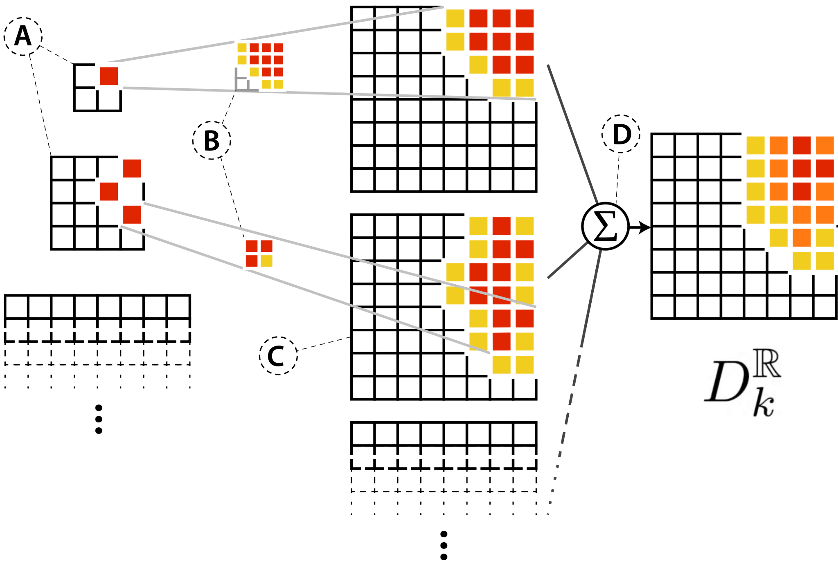
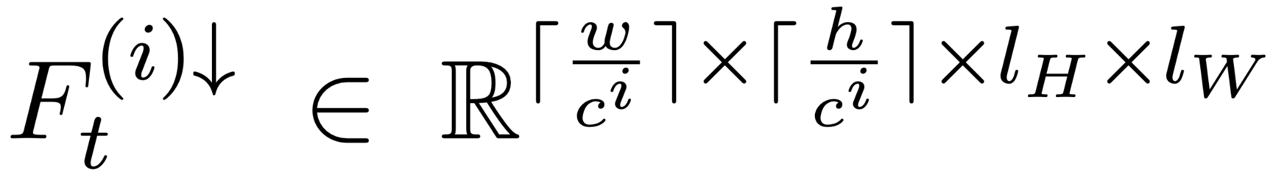
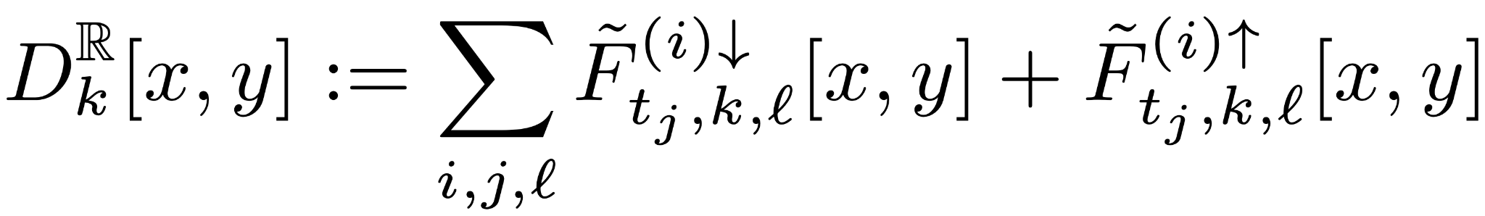
DAAM Attention Maps
F_{t}^{(i)} from UNet block i
Bicubic Interpolation
Summed map for word k
Cross-Attention Map for block i at time t
Number of words in prompt
Width, height of downsampled UNet block
Number of attention heads
Summed map for each word k, k ∈ {1,.., l_{W}}
Downsampling blocks
Upsampling blocks
Sum across: UNet blocks i, timesteps j, attention heads l

Slide 22
Outline
Background: Stable Diffusion
DAAM for text-to-image attribution
Results
Attribution quality analysis
Syntax to pixels
Entanglement
Related work
Limitations & discussion

Slide 23
Attribution Analysis Part 1: Object Attribution
We can evaluate DAAM as an image-segmentation tool

Slide 24
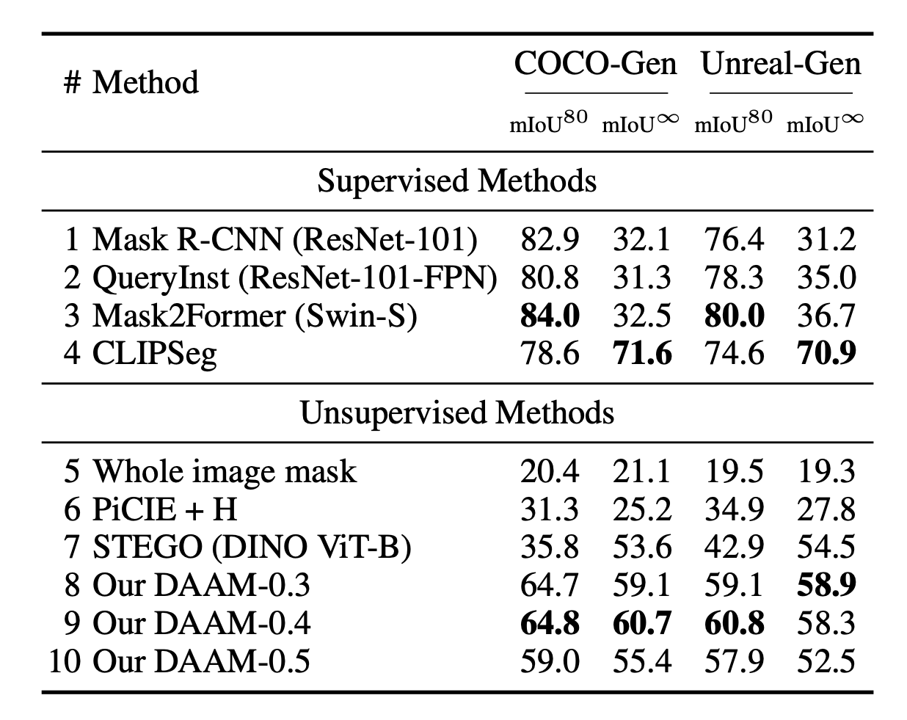

DAAM segments Stable Diffusion images
DAAM does not require explicit segmentation labels
DAAM is “open vocabulary” – can segment for any text input (not limited to known classes)

Slide 25
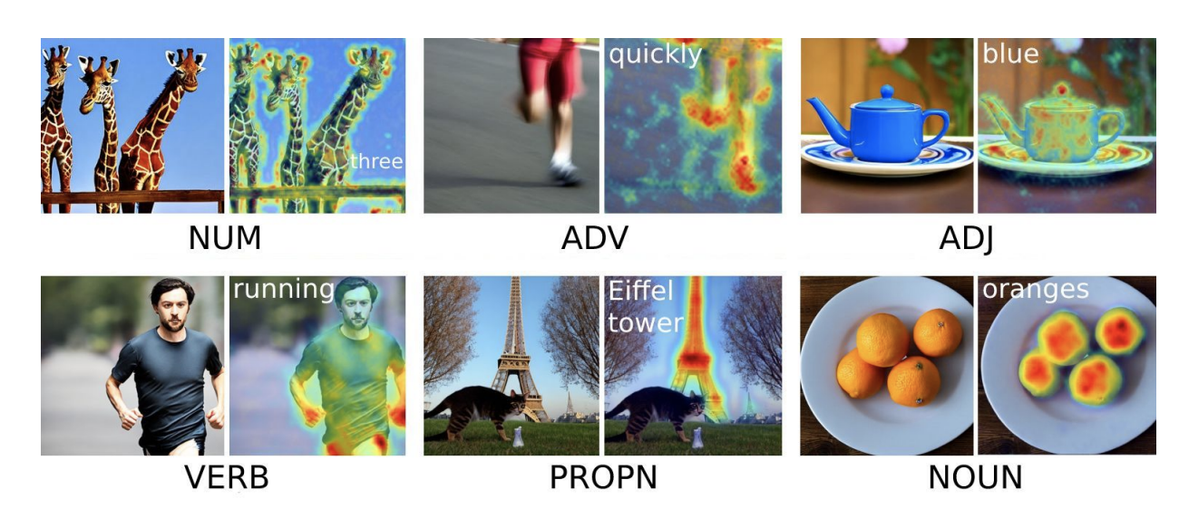
Attribution Analysis Part 2: Generalized Attribution
DAAM can segment beyond nouns

Slide 26
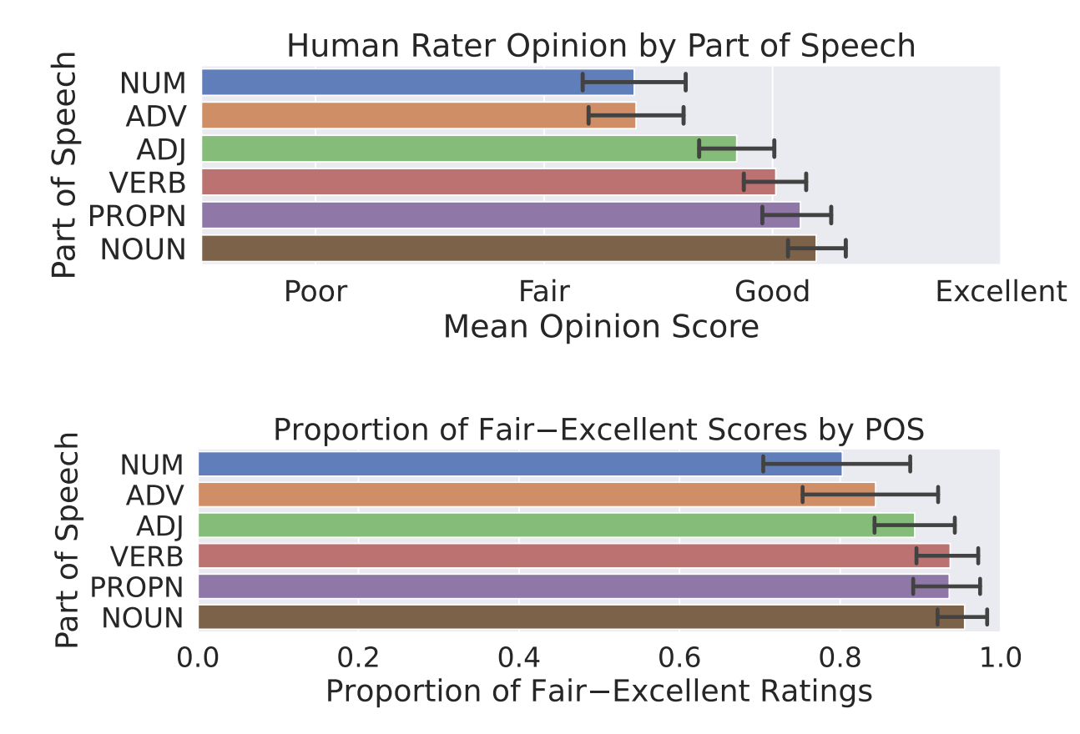
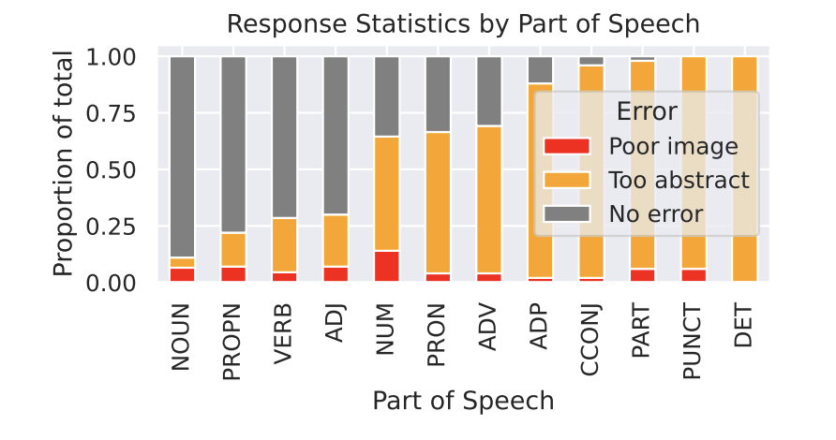
Evaluating DAAM with a user study
50 annotators, none see more than 18% of images
Every image has three raters
Abstract words / poor images were thrown out of evaluation

Slide 27

Visuosyntatic Analysis
How does syntax relate to the generated pixels?

Slide 28
Visuosyntatic Analysis
Head-Dependent Pairs
The cat sat on the mat
The red car
She ate the pizza

Slide 29
Visuosyntatic Analysis
Head-Dependent Pairs
The cat sat on the mat
The red car
Head because subject of sentence
Dependent because mat is the object of the sentence
Dependent because “red” is an adjective that describes the noun “car”
Head because main noun that represents the object being described
She ate the pizza
Head because main verb that describes the action being performed
Dependent because it is the noun that receives the action being performed

Slide 30
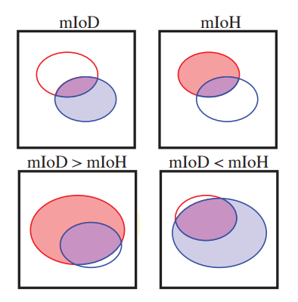
Visuosyntatic Analysis
Measures of Overlap
Mean Intersection over Union (mIoU)
Mean Intersection over the Dependent (mIoD)
Mean Intersection over the Head (mIoH)

Slide 31
Visuosyntatic Analysis
Measures of Overlap
Mean intersection over union (mIoU)
Mean Intersection over the Dependent (mIoD)
Mean Intersection over the Head (mIoH)

Slide 32
Visuosyntatic Analysis
Measures of Overlap
Mean intersection over union (mIoU)
Mean Intersection over the Dependent (mIoD)
Mean Intersection over the Head (mIoH)

Slide 33
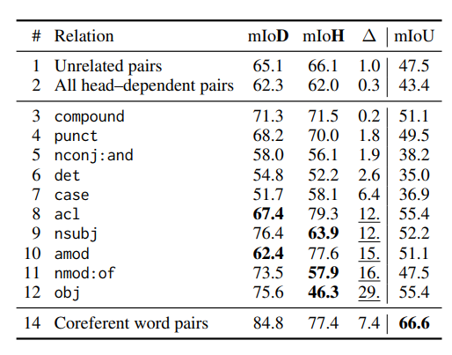

Visuosyntatic Analysis
Noun Compounds
ice
cream

Slide 34
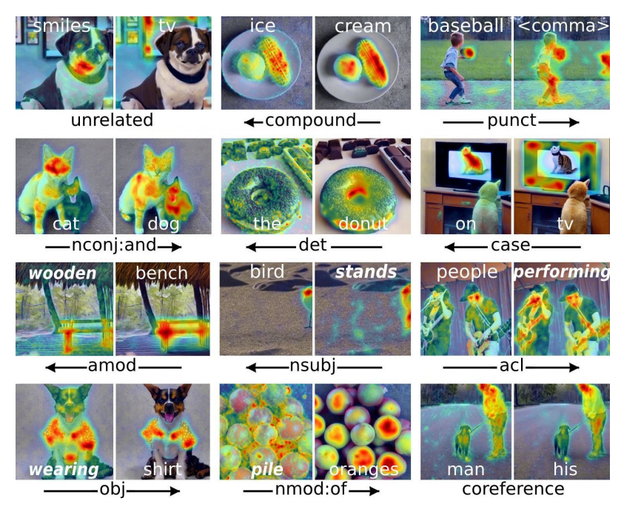
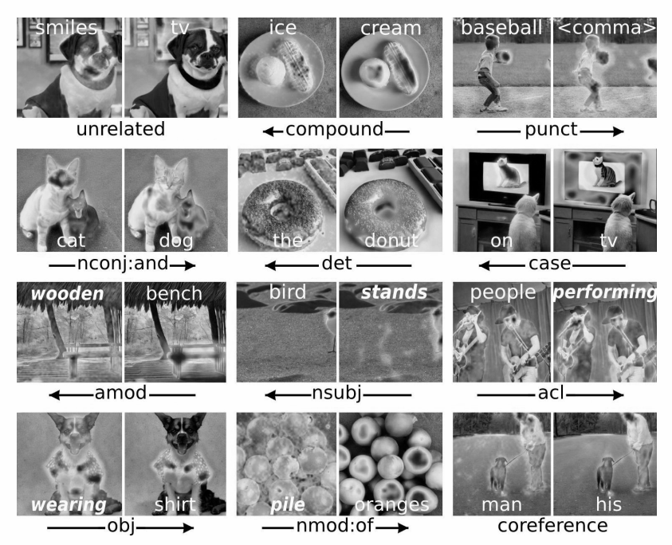
Visuosyntatic Analysis
Noun Compounds
ice
cream
Takeaway:
No dominance
Complement one another

Slide 35
Visuosyntatic Analysis
Punctuation & Articles
the
donut
baseball
<comma>

Slide 36
Visuosyntatic Analysis
(normalized)
Punctuation & Articles
the
donut
baseball
<comma>
Takeaway:
No dominance
Little semantic meaning

Slide 37
Visuosyntatic Analysis
Nouns Connected w/ “and”
cat
dog

Slide 38
Visuosyntatic Analysis
Visuosyntatic Analysis
Nouns Connected w/ “and”
cat
dog
Takeaway:
Feature Entanglement

Slide 39
Visuosyntatic Analysis
Dependent
Verb & Subject
Head & Dominant
bird
stands
Verb & Object
wearing
shirt
Head & Dominant
Dependent

Slide 40
Visuosyntatic Analysis
Visuosyntatic Analysis
Dependent
Verb & Subject
Head & Dominant
bird
stands
Verb & Object
wearing
shirt
Head & Dominant
Takeaway:
Dependent
Semi-intuitive
Head verb dominates subject/object
Verb contextualises the subject/object in its surroundings

Slide 41
Visuosyntatic Analysis
Nominal Dependents
Pile
Oranges
“of”
Head & Dominant
Dependent

Slide 42
Visuosyntatic Analysis
Visuosyntatic Analysis
Nominal Dependents
Pile
Oranges
“of”
Head & Dominant
Dependent
Takeaway:
Dominance is intuitive

Slide 43
Visuosyntatic Analysis
Adjective Modifiers
Wooden
Bench
Dependent & Dominant
Head & Not Dominant

Slide 44
Visuosyntatic Analysis
Visuosyntatic Analysis
Adjective Modifiers
Wooden
Bench
Dependent & Dominant
Head & Not Dominant
Takeaway:
Dominance is counter intuitive

Slide 45
Visuosyntatic Analysis
How does syntax relate to the generated pixels?
Takeaway:
Attribution map of the dependent subsumes that of the head, and opposite for others
Dominance is intuitive in some cases but counter intuitive in others

Slide 46
Visuosemantic Analysis
Do semantically similar words have worse generation quality?

Slide 47
Visuosemantic Analysis: Cohyponym Entanglement
Prompt Structure:
“a(n) <noun> and a(n) <noun>”
Cohyponym Example:
“a giraffe and a zebra”
Non-Cohyponym Example:
“a zebra and a fridge”

Slide 48
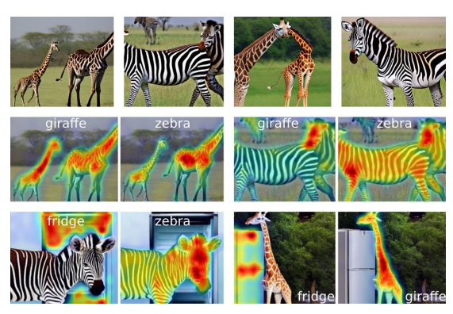
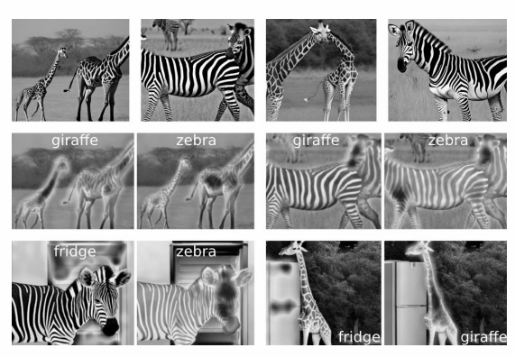
Visuosemantic Analysis: Cohyponym Entanglement
Cohyponym
“a giraffe and a zebra”
Takeaway
Stable-Diffusion image generation worsens
Generates one of the nouns but not both
Attribution maps for the two nouns overlap … Feature Entanglement

Slide 49
Visuosemantic Analysis: Cohyponym Entanglement
Non-Cohyponym
“a zebra and a fridge”
Takeaway
Generates both of the nouns
Attribution maps for the two nouns are distinct

Slide 50
Visuosemantic Analysis: Adjectival Entanglement
Prompt Structure:
“<adj> <noun> <verb phrase>”
Example:
“a [rusty] shovel sitting in a clean shed”
“a [bumpy] ball rolling down a hill”

Slide 51
Visuosemantic Analysis: Adjectival Entanglement
Expected Behavior
If no entanglement, background should not gain attributes pertaining to that adjective

Slide 52
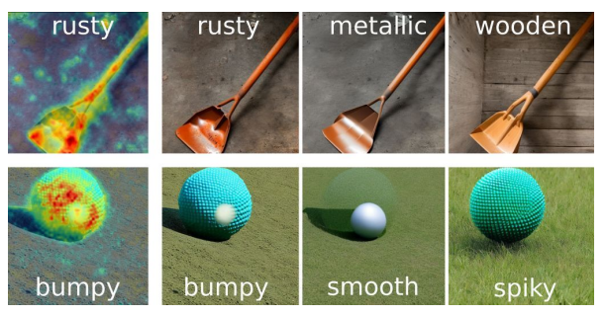
Visuosemantic Analysis: Adjectival Entanglement
Takeaway
Attribution maps for adjectives attend too broadly across images beyond nouns they modify … Feature Entanglement

Slide 53
Summary
DAAM provides pixel-level attribution maps for Stable Diffusion, a state-of-the-art text-to-image generator
These maps appear to be informative, as evaluated through segmentation tasks and user study
DAAM can be a useful tool for further understanding and analyzing Stable Diffusion – e.g. through visuosyntactic analysis and visuosemantic analysis

Slide 54
Class Discussion
Does DAAM give a clear understanding about how a large-scale latent diffusion model synthesizes text to image and which parts of an image is influenced the most?
Does DAAM explain all the dynamics of how images are synthesized? If not, how should DAAM be modified to better explain image generation?
Other explanatory tools besides attention and segmentation proposals?
DAAM pointed out failure cases of stable-diffusion. Are there further interpretability methods needed to understand why feature entanglement is occurring and how it could be improved?

